Slide 1

Functionalities
Can view a percentage bar chart of the quantity of good and bad bottles in a particular time frame.
To be able to visualize the images of the bottles as good, bad or all.
01
02

Slide 2

SYSTEM REQUIREMENTS:
NON FUNCTIONAL REQUIREMENTS
User must be able to access courses in progress.
EACH PAGe must load within 2 seconds.
THE System must meet Cloud Content Accessibility
Guidelines.
DATABAse security must meet cloud requirements.
ADMINISTRATOR MUst be able to add and configure
new courses

Slide 3
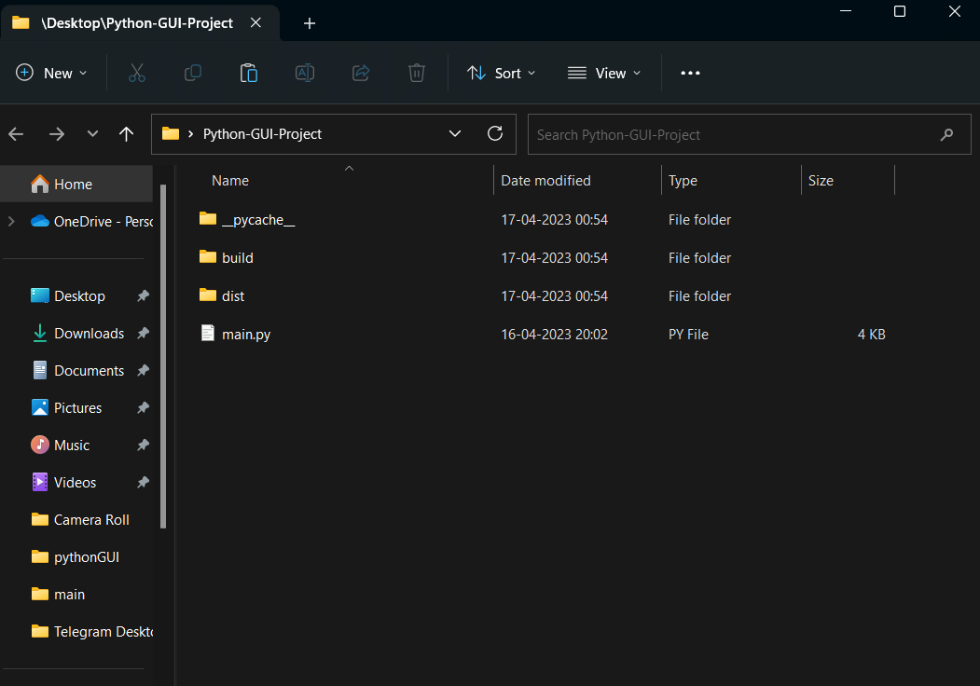

Extract the zip file.
You shall see the following folder.

Slide 4
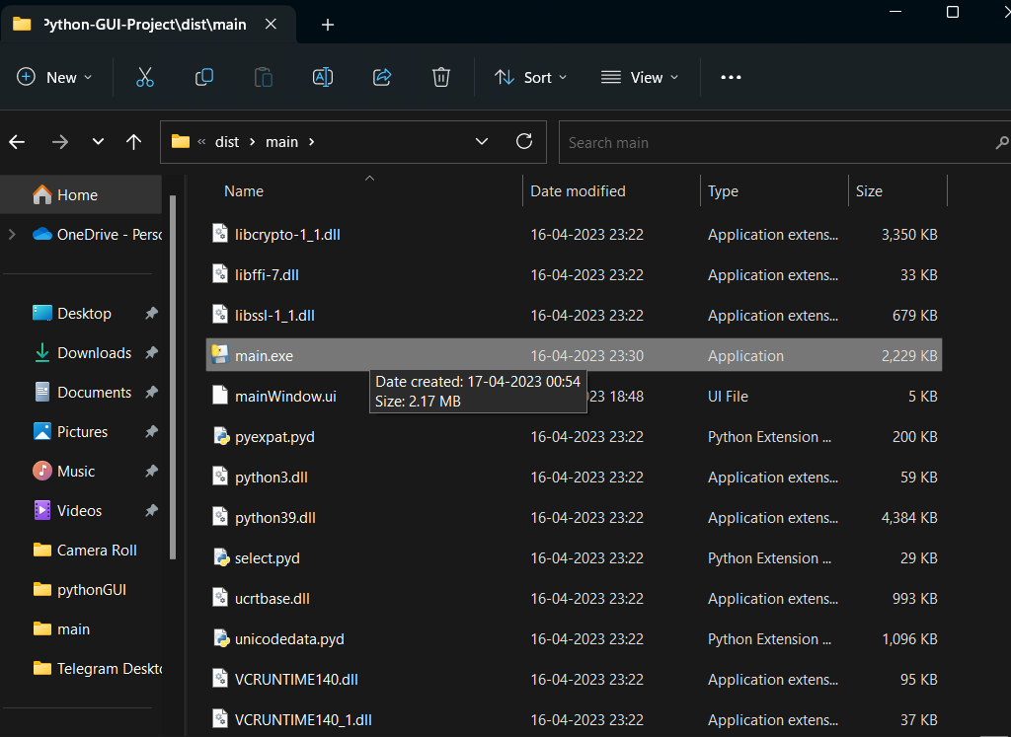
Go to dist/main/main.exe
Execute it.

Slide 5
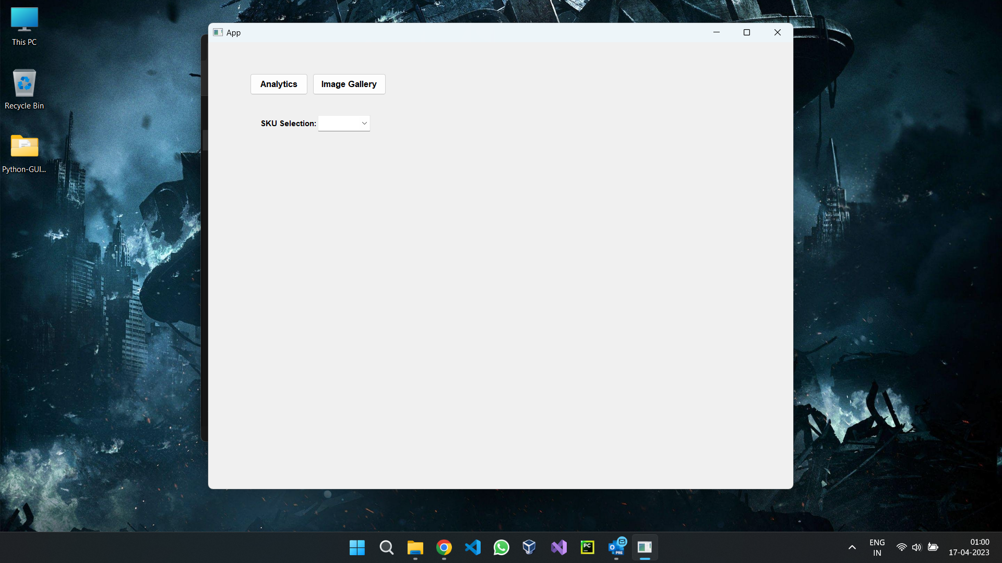
The application should startup within a few seconds.
You can see the home screen.

Slide 6

The analytics provides the facility of visualizing a graph percent chart.
Select a SKU id to load the graph.

Slide 7
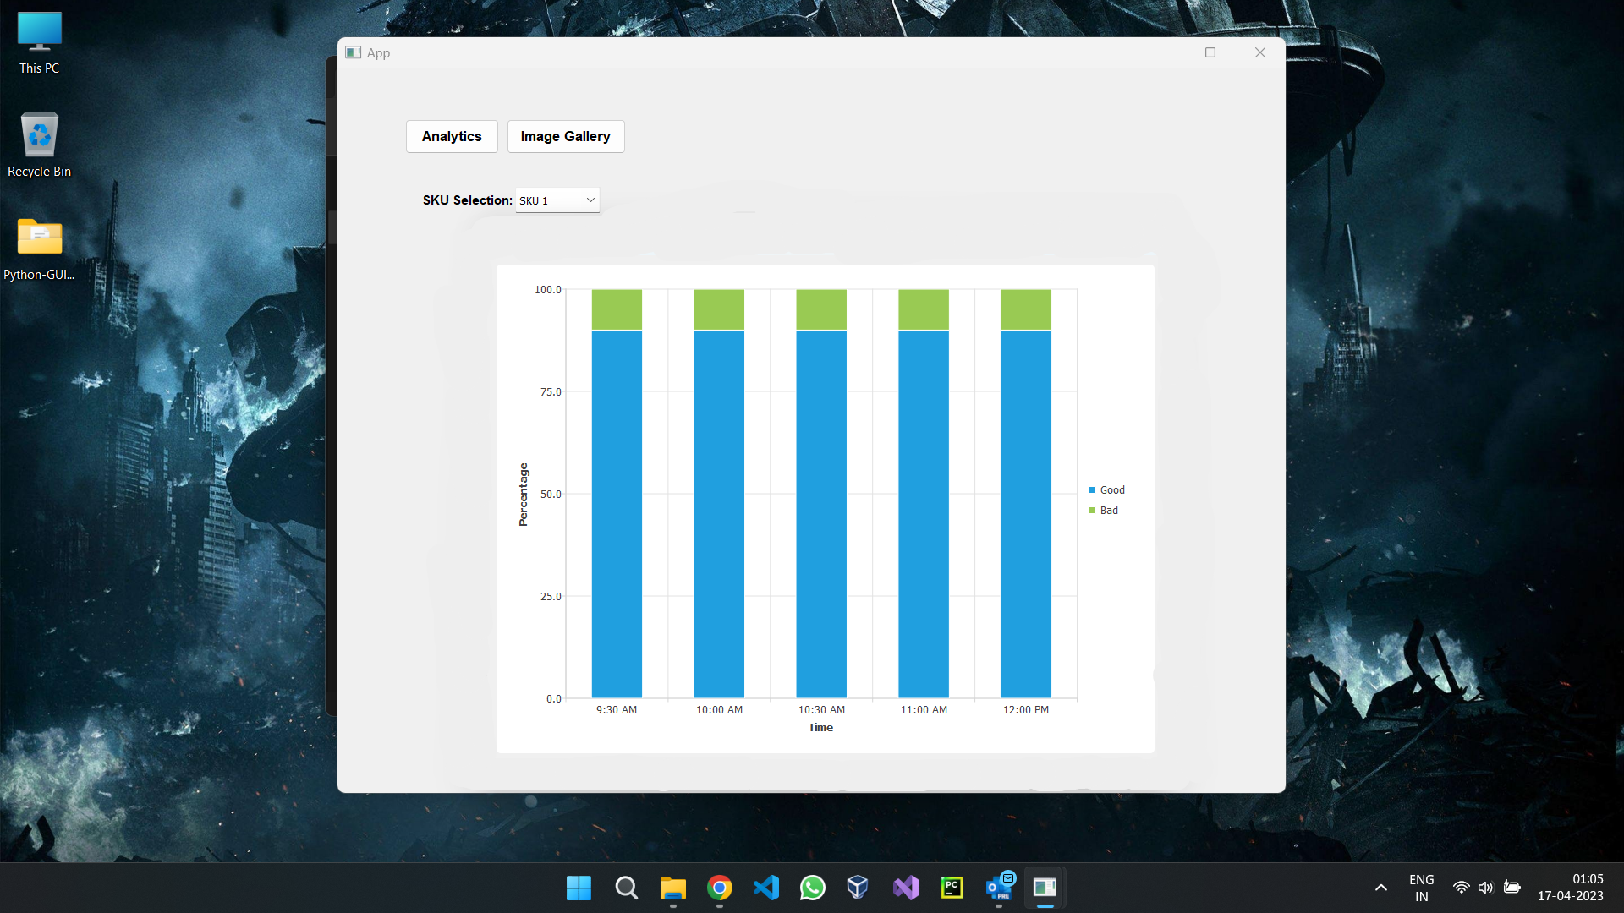
The graphed view

Slide 8
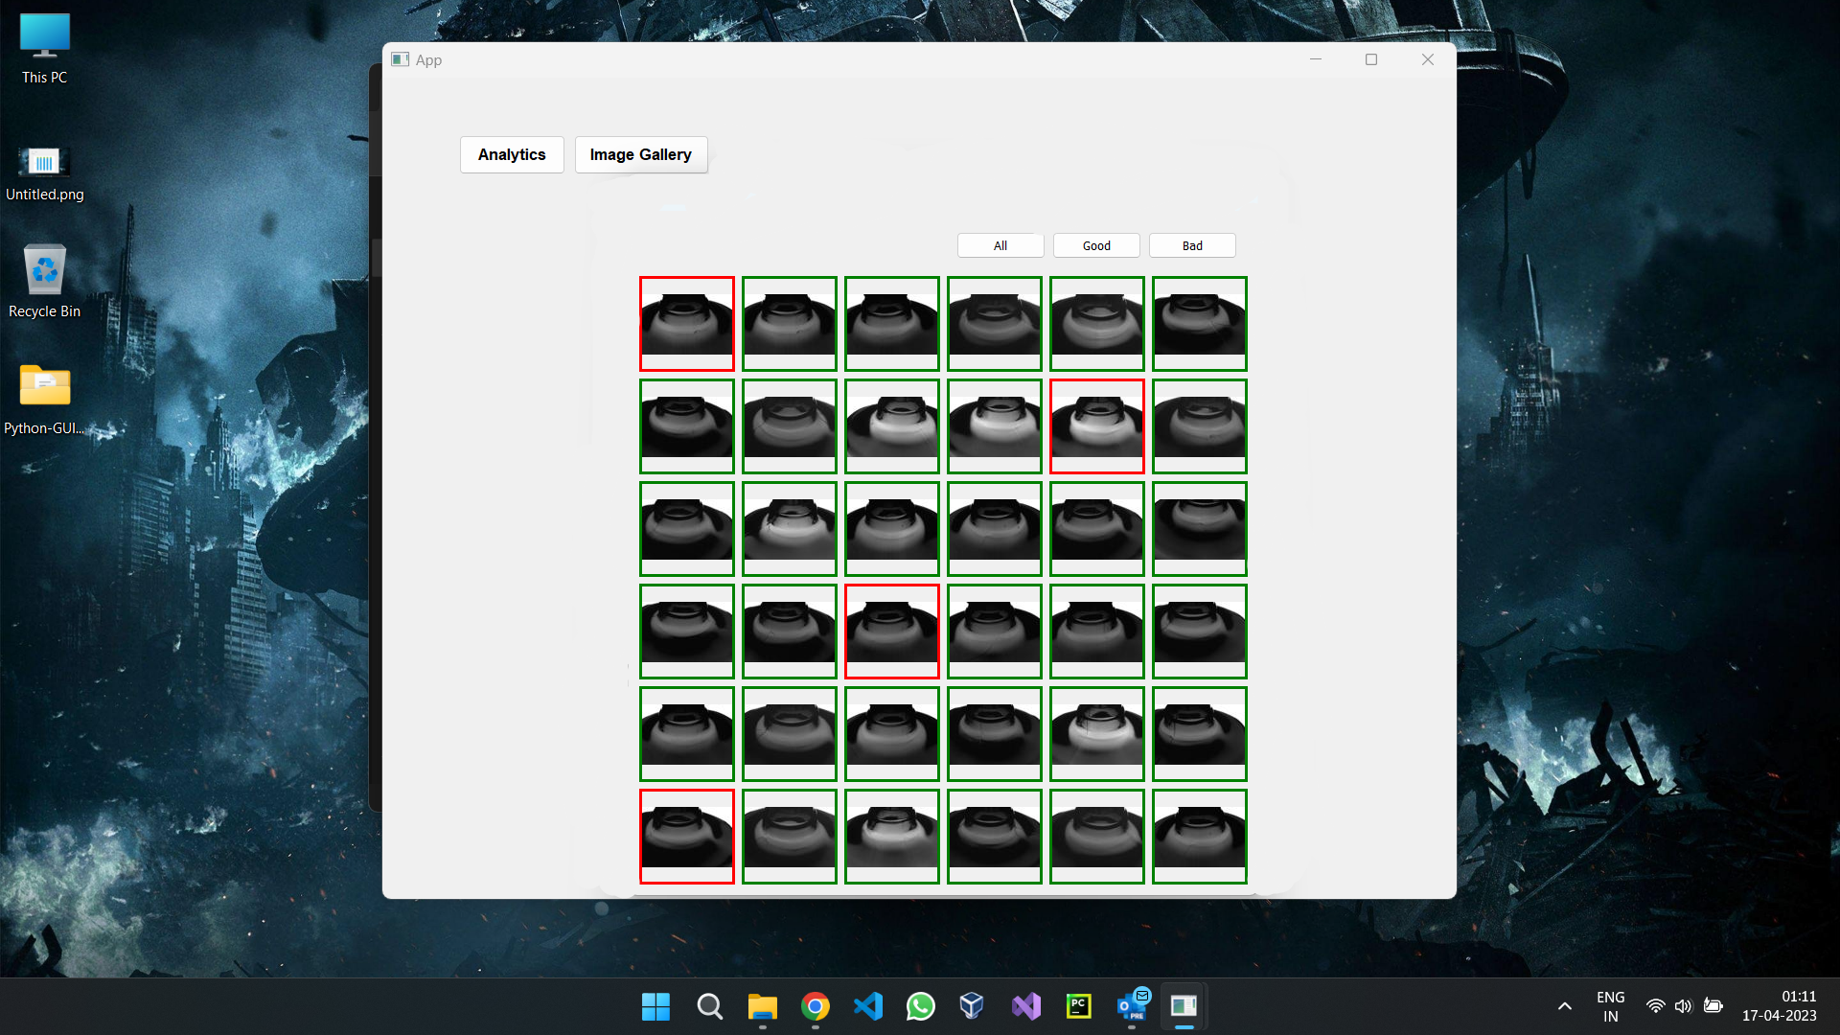
Now you can use the Image Gallery tab to see the: All, Good, Bad images captured.

Slide 9
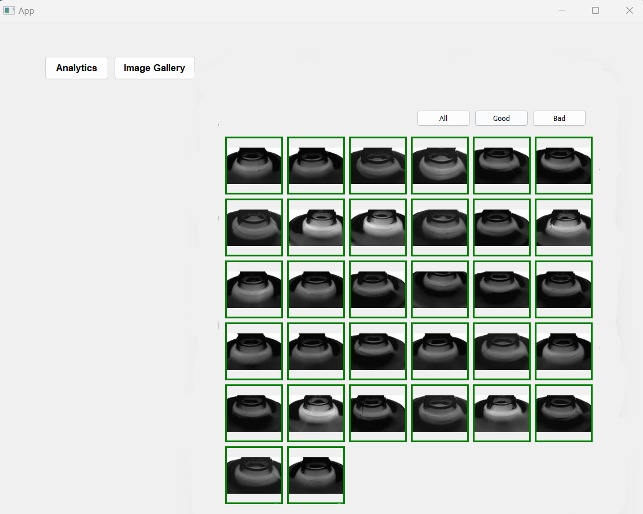
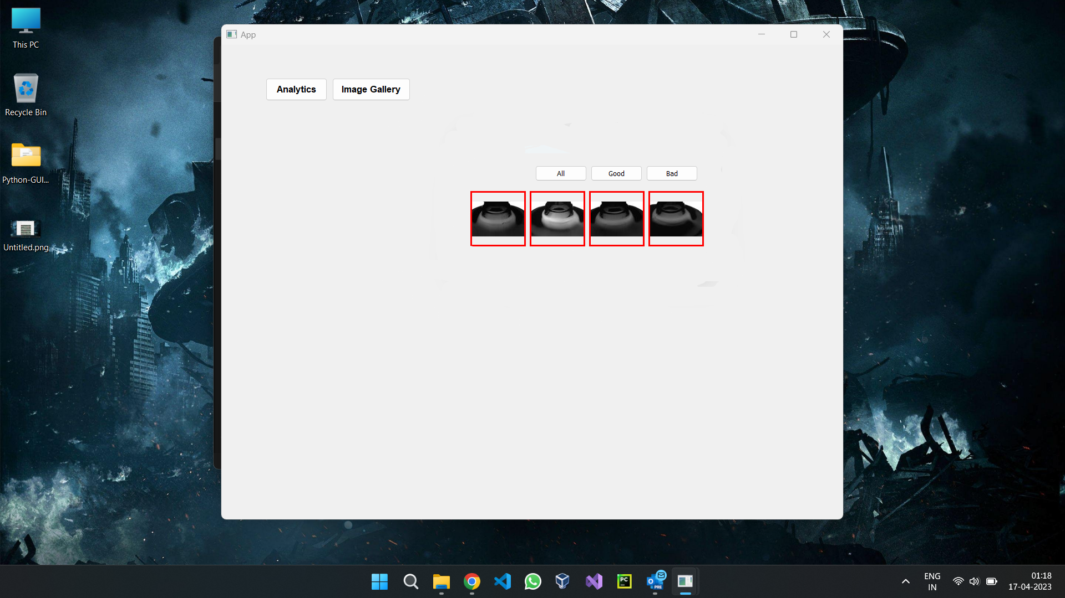

Slide 10
THANK YOU

